Slide 1
http://confusedofcalcutta.com/2012/01/09/more-on-know-how-and-know-why-versus-know-what-2
“It is in the knowledge of the Why that the foundation of the How is laid. The What is just an instance of the How. […What doesn't Matter. What matters is How. How Doesn't Matter if you don't know Why.....]”

Slide 2

Enterprise 2.0/3.0
Rajeev Kumar
ECT424/IS324 Summer 2015

Slide 3

Let’s start the course with an exam from the readings

Slide 4
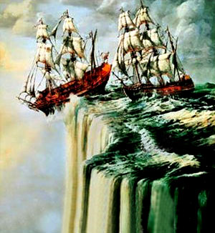
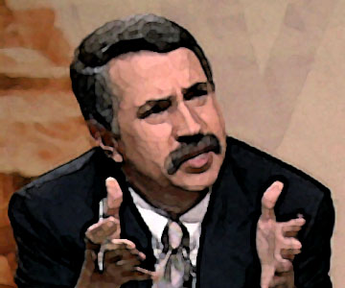

What key events does Friedman surface?
Fall of the Wall
Dot Com Boom
Y2K Opportunity
What are the implications on the nature of the enterprise?
Outsourcing
Insourcing
Offshoring
Supply Chaining
Open Sourcing
What are Friedman’s other flatteners?
What are the implications on the nature of work?
Informing
Ubiquitous Access

Slide 5

What is this course about?

Slide 6
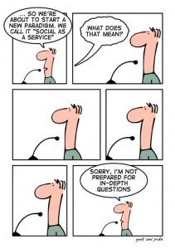

Slide 7
Shifting Skills in IT
Notes:
IT is becoming more of a SUPPLY CHAIN than traditional infrastructure.
Notice that the Top IT Skills considered important today are : Vendor/Service Provider Management, Business Process Management and Communication skills

Slide 8
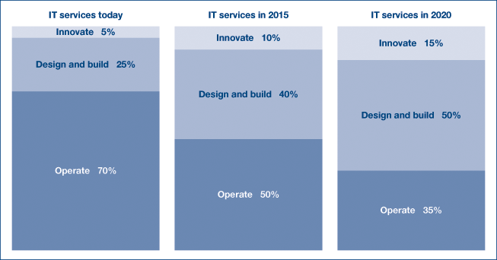
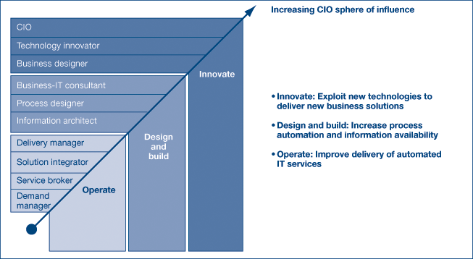
Shifting Roles
Gartner, 11/11, http://my.gartner.com/portal/server.pt?open=512&objID=260&mode=2&PageID=3460702&resId=1855718&ref=QuickSearch&sthkw=it+skills New Skills for the New IT

Slide 9

Why do I care?

Slide 10
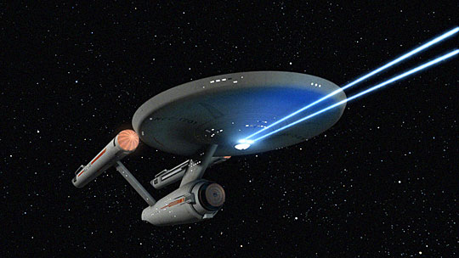
What makes an Enterprise?
A business enterprise is any type of operation that is involved in providing goods or services with the anticipated outcome of earning revenues (profit).
The broad nature of a business enterprise allows the term to be applied to any type of company or firm that is geared toward generating revenue by selling products/services of any type.
It is not unusual for the terms company, firm, and business enterprise to be used interchangeably.

Slide 11
Extended-enterprise
Stakeholders in the broader ecosystem
(includes non-clients, anti-clients, government, general community)
(enterprise bounded by shared commitment to the vision)
Prospects
Clients
Partners
Organization
(bounded by rules)
(boundaries may be partly porous)
Service Providers
may also be
clients or
prospects
may also be
clients or
prospects
(must share
same vision)
(must acknowledge
and align to vision)

Slide 12
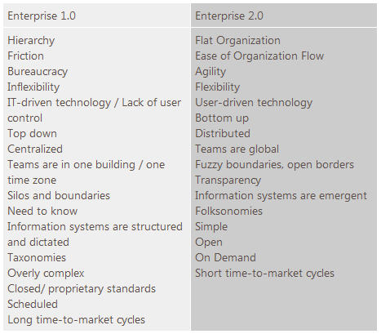
The Enterprise
Web 1.0
Static pages
Static content
One way communciation
Notes:
The Enterprise 1.0 organization was a hierarchical, bureaucratic, IT driven (think mainframe), siloed and ruled from the top.
The Enterprise 2.0 organization is teams, collaborative, distributed, FLAT, agile and BUSINESS driven.

Slide 13
Enterprise 2.0 Characteristics
Web 2.0
Enterprise 2.0
Communication
Collaboration
Information Storage/Retrieval/Mining
Connectivity (internetworking)
Internet/Web/Mobile
Hardware (processing/storage architectures)
Cloud/SAAS
Bottom up
Still performed on site,
Improvements in technology infrastructure bring some flexibility to the workplace
Increase in collaboration
Flattened management
Increase in virtual work

Slide 14
Work 3.0 ?
Mobile Work
Remote (virtual)
Cloud supported work tools (on-demand, from any where)
Notes:
Why is it called Work 3.0? -- you guessed it – Mobile Work Force!

Slide 15
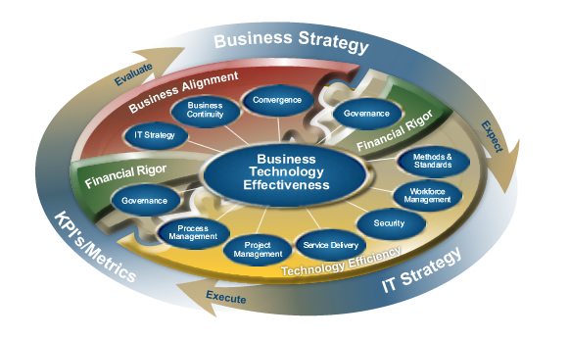
The Role of IT
http://www.agsi.com/BTE-governance.shtml

Slide 16
IT in the Business
IT allows services to be provided and information to be transferred around the globe almost instantaneously
enables knowledge workers who are separated by great distances to share resources simultaneously
gives customers the option to make purchases anytime from any where
expedites the pace of global decision making.
Notes:
IT is Critical to Business. Without IT business can not expand, customers can not demand and businesses can not supply.
IT is the medium for DEMAND and SUPPLY

Slide 17
Scope of IT
Businesses depend on IT to
Develop a competitive edge
both domestic and global marketplaces
Business models may be based entirely on information management
Organizations are focusing efforts on
Improving IT structural design
Consolidating data repositories
Connecting with customers
Automating the supply chain
Deploying applications enabling business services

Slide 18
Enterprise Architecture
The fundamental purpose of IT is to enable organizations to accomplish their business purposes.
Most effective with a structure to make IT decisions.
Structure is called Enterprise Architecture (EA)
Computers, just like people, perform different roles in a company.
Enterprise architecture
like an organizational chart that details the roles, responsibilities, and reporting relationships among employees.
Notes:
IT is the GLUE between the customer and the business

Slide 19
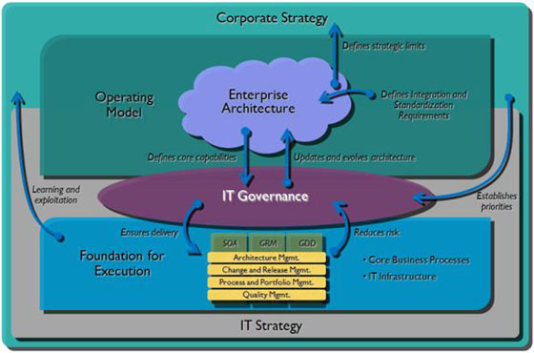
EA fits Here
Notes:
Think of this as a PLACEMAT.

Slide 20
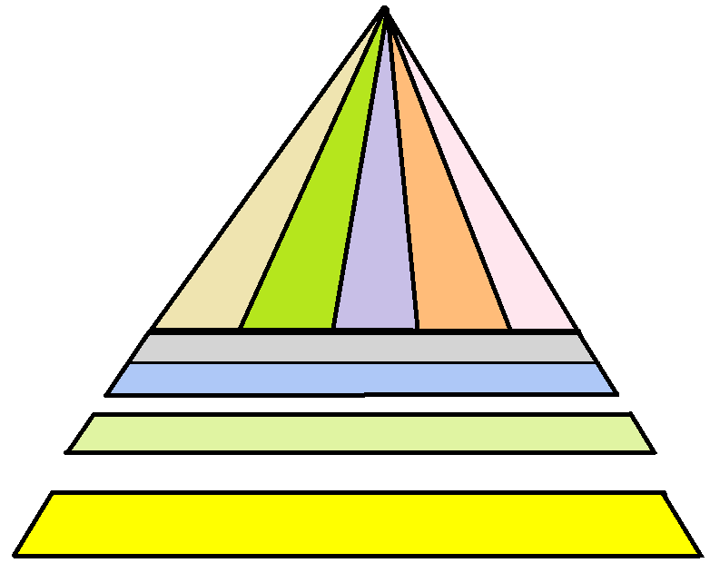
Exec Dashboard
___________
Expert Systems, BI, Dashboard
___________
BI, Dashboard, Expert Systems,
___________
Dashbd, Office Automation,
Exprt Sys, BI
___________
Office Automation
Execs –Strategic
__________________
Knowledge Workers
__________________
Middle Mgmt– Tactical
__________________
Lower Mgmt – Operational
__________________
Clerical Staff
Finance IS
Accounting IS
Marketing IS
POM IS
HR IS
Enterprise Resource Planning systems
Transaction Processing Systems
IT Services
IT Infrastructure
IT Personnel
IT Components
Platform

Slide 21
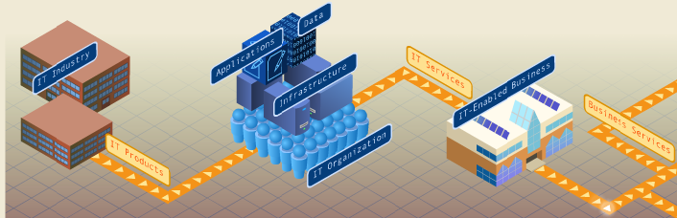
Another IT Framework
Data
Applications
Infrastructure
IT Organization

Slide 22
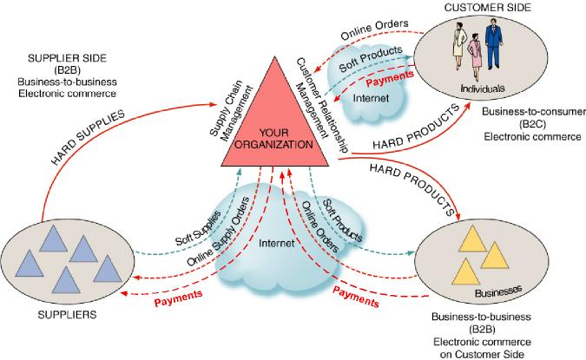
Information Technology Outside the Organization
Notes:
OAS= Office Automation Systems

Slide 23
Models
Before we launch into networking, cabling and connectivity,
We should discuss models of networking.

Slide 24

What is a model?

Slide 25

Models allow us to abstract information
Models allow us to reduce information
On a project, all models must depict the same reality
A representational abstraction of reality
for the purpose of better understanding a subset of constructs of that reality

Slide 26
Models and Modeling
Models allow us to abstract information
Models allow us to reduce information
All models of the same object must depict the same reality

Slide 27
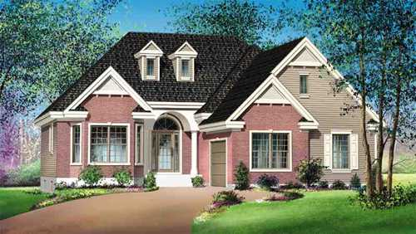
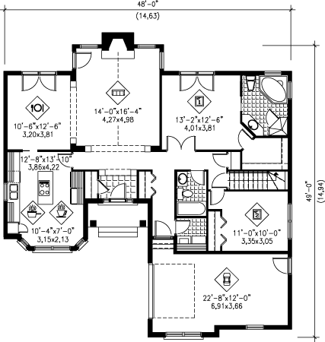
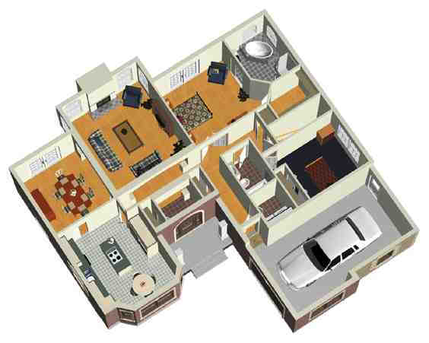
These are all models of a house

Slide 28


Two Networking Models
Sarah, I have to tell you about the OSI Model. It describes networking in seven layers.
But Justin, the DoD Model better depicts TCP/IP networking and only uses four layers to do so.

Slide 29
OSI Model
 | Data unit | Layer | Function
Host layers | Data | 7. Application | Network process to application
 |  | 6. Presentation | Data representation, encryption and decryption, convert machine dependent data to machine independent data
 |  | 5. Session | Interhost communication
 | Segments | 4. Transport | End-to-end connections and reliability, Flow control
Media layers | Packet | 3. Network | Path determination and logical addressing
 | Frame | 2. Data Link | Physical addressing
 | Bit | 1. Physical | Media, signal and binary transmission
Notes:
Transport Set
Layer 1: Physical - This is the level of the actual hardware. It defines the physical characteristics of the network such as connections
Layer 2: Data - In this layer, the appropriate physical protocol is assigned to the data. Also, the type of network and the packet sequencing is defined.
Layer 3: Network - The way that the data will be sent to the recipient device is determined in this layer. Logical protocols, routing and addressing are handled here.
Layer 4: Transport - This layer maintains flow control of data and provides for error checking and recovery of data between the devices.
Application Set
Layer 5: Session - Layer 5 establishes, maintains and ends communication with the receiving device.
Layer 6: Presentation - Layer 6 takes the data provided by the Application layer and converts it into a standard format that the other layers can understand.
Layer 7: Application - This is the layer that actually interacts with the operating system or application whenever the user chooses to transfer files, read messages or perform other network-related activities.
Bit is the basic unit of information
Frame is a digital data transmission unit
Network Packet is a formatted unit of data
Network segment is a portion of a computer network

Slide 30
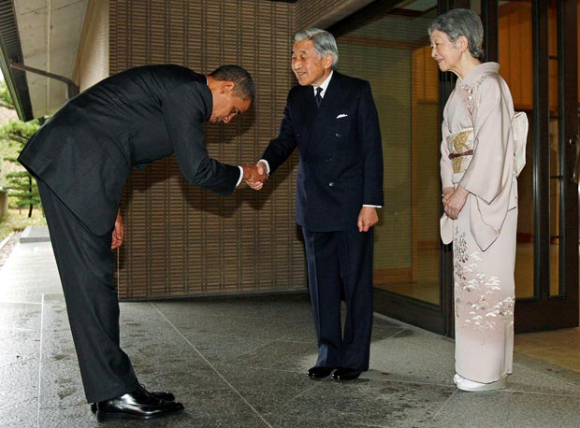
A word About Protocols
Agreed format for data exchange
Defines common set of rules and signals for computers on a network

Slide 31
Layer | OSI protocols | TCP/IP protocols | AppleTalk
Application | FTAM, X.400, X.500, DAP, ROSE, RTSE, ACSE | NNTP, DNS, FTP, Gopher, HTTP, NFS, NTP, DHCP, SMTP, SNMP, Telnet | AFP, ZIP, RTMP, NBP
Presentation | ISO/IEC 8823, X.226, ISO/IEC 9576-1, X.236 | MIME, SSL, TLS, XDR | AFP
Session | ISO/IEC 8327, X.225, ISO/IEC 9548-1, X.235 | Sockets. Session establishment in TCP, SIP, RTP | ASP, ADSP, PAP
Transport | ISO/IEC 8073, TP0, TP1, TP2, TP3, TP4 (X.224), ISO/IEC 8602, X.234 | TCP, UDP, SCTP, DCCP
Network | ISO/IEC 8208, X.25 (PLP), ISO/IEC 8878, X.223, ISO/IEC 8473-1, CLNPX.233. | IP, IPsec | ATP (TokenTalk or EtherTalk)
Data Link | ISO/IEC 7666, X.25 (LAPB), Token Bus, X.222, ISO/IEC 8802-2 LLC Type 1 and 2 | PPP, SLIP, PPTP, L2TP | LocalTalk, AppleTalk Remote Access, PPP
Physical | X.25 (X.21bis, EIA/TIA-232, EIA/TIA-449, EIA-530, G.703) |  | RS-232, RS-422,
See Justin, you’ve never heard of any of those OSI protocols. Now let me show you how much simpler the TCP/IP/DoD model is.

Slide 32
TCP/IP/DoD Model
Process Layer
FTP HTTP IMAP IRC LDAP SSH SSL SMTP
Host to Host Layer
TCP UDP SCTP WAP
Internet Layer
IPv4 IPv6 IPsec
Network Access Layer
Ethernet DSL ISDN FDDI PPP
Physical Layer

Slide 33
OSI Model
 | Data unit | Layer | Function
Host layers | Data | 7. Application | Network process to application
 |  | 6. Presentation | Data representation, encryption and decryption, convert machine dependent data to machine independent data
 |  | 5. Session | Interhost communication
 | Segments | 4. Transport | End-to-end connections and reliability, Flow control
Media layers | Packet | 3. Network | Path determination and logical addressing
 | Frame | 2. Data Link | Physical addressing
 | Bit | 1. Physical | Media, signal and binary transmission
DoD Model
Process
Host to Host
Internet
NW Access
Physical

Slide 34
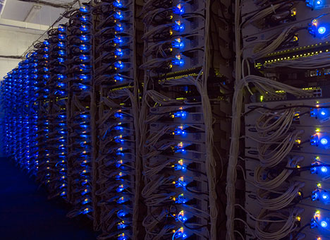
It starts with hardware

Slide 35
Hardware
It all starts with a computer
All computing devices share components

Slide 36
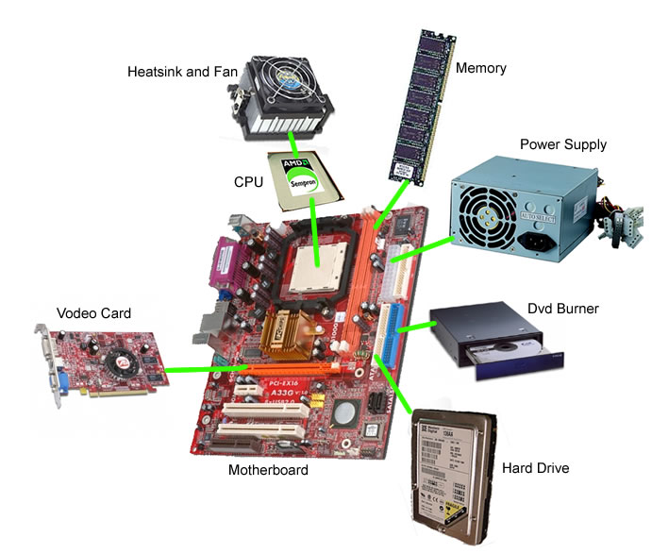
IT Hardware
Computer Parts

Slide 37
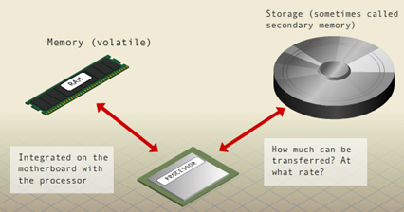
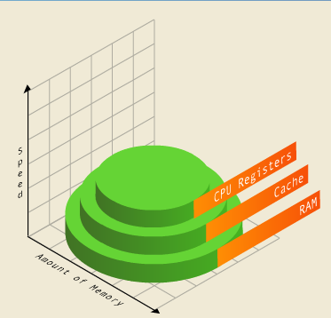
Memory
One problem that computer designers encounter is that processors can receive and manipulate data much more quickly than most forms of memory can supply data.
A computer uses different types of memory to avoid forcing the processor to wait for the delivery of data from slow (but cheap) memory or to rely completely on very fast, very expensive memory.
In the tiered memory pyramid, a very small amount of fast, expensive memory is backed up by larger amounts of slower, cheaper memory.

Slide 38
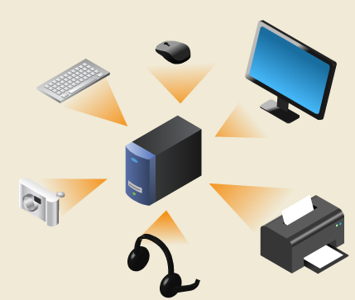
Peripherals
Provide I/O (input/output)

Slide 39
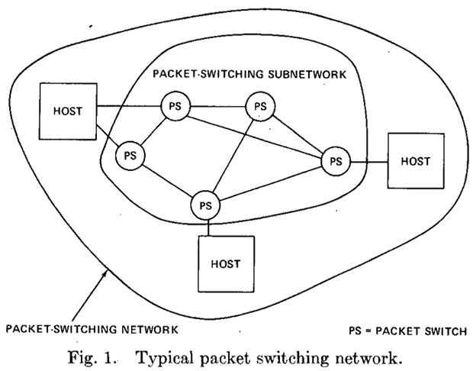
Nodes
These are the individual elements that form the foundation for all IT
These are the workstations, tablets, smartphones, servers, switches, routers

Slide 40
Your take away from all of this
Sarah, here is what you should remember.
Models are abstractions.
These networking models simply help us keep track of protocols and map how they relate to one another.
We can use these models to keep track of what kinds of issues are important to address when constructing a networking solution.
We make decisions among like technologies at the same layer.
All layers must be addressed for a successful networking solution.

Slide 41
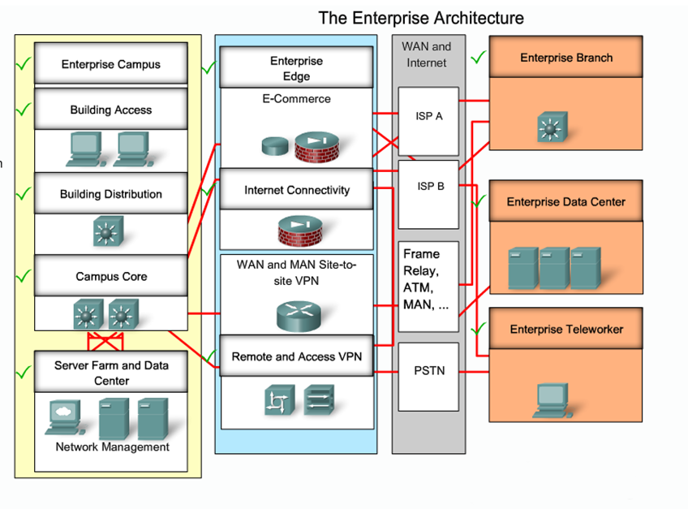
Next class… the LAN
The models are just way of explaining the rules for communications between nodes
©Cisco 2010

Slide 42

Syllabus

Slide 43
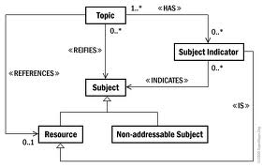
What subjects will we cover?

Slide 44
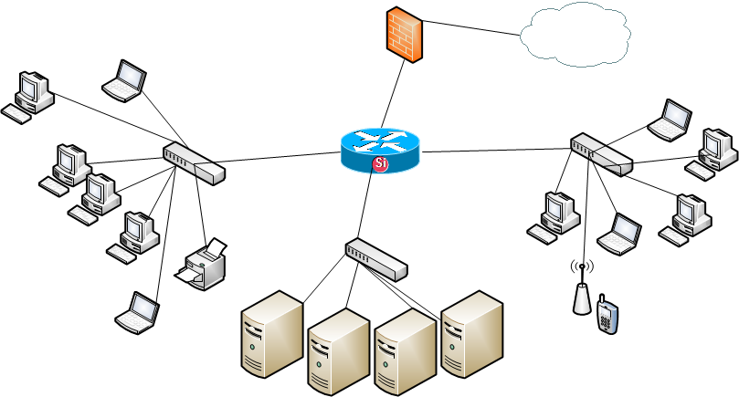
Local Area Networks, Protocols as they support, Enterprise Applications

Slide 45
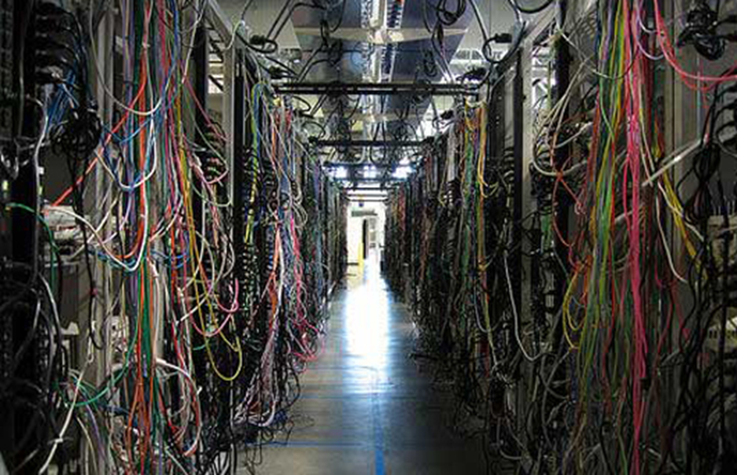
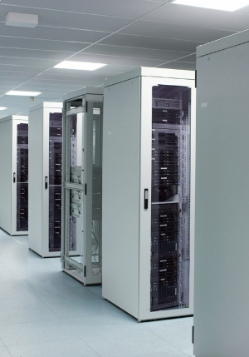
IT infrastructure

Slide 46
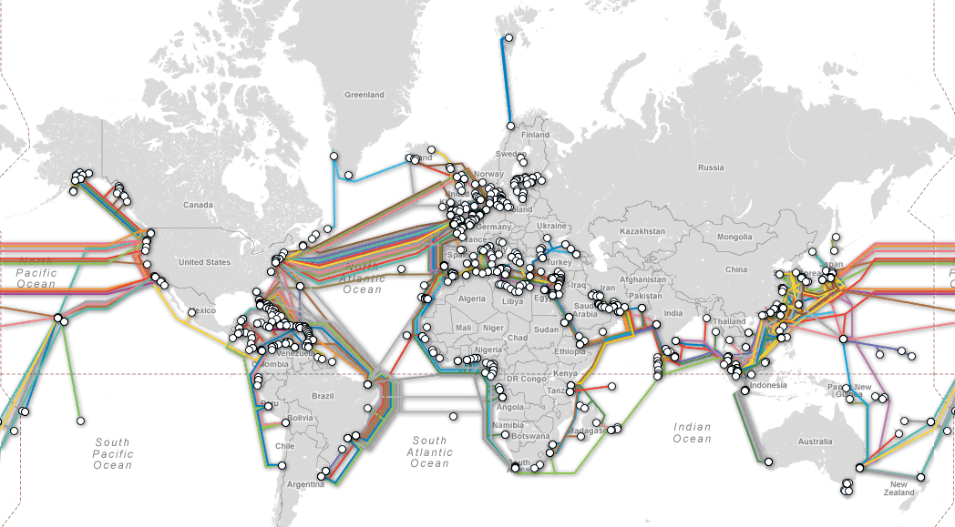
WANs

Slide 47
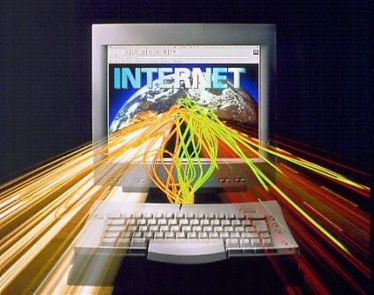
Introduction to Internet Infrastructure and Data Center Issues

Slide 48
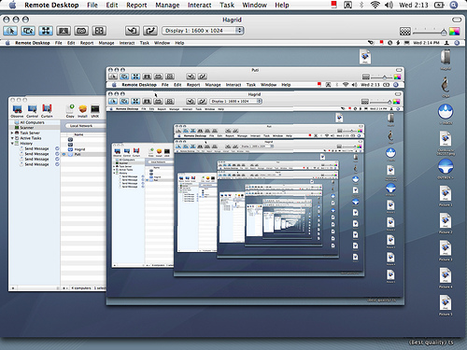
Desktop vs. web client

Slide 49
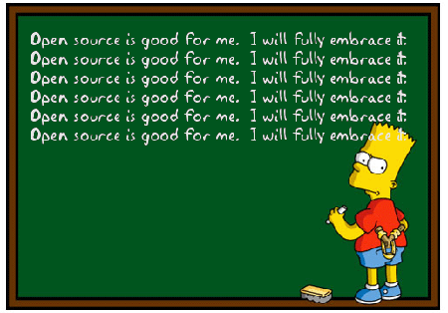
open vs. closed source

Slide 50

Mobile
Computing

Slide 51

Cloud computing Models and applications

Slide 52

Self hosted vs. cloud (SaaS)
Notes:
Software as a service (SaaS) is a software licensing and delivery model in which software is licensed on a subscription basis and is centrally hosted.

Slide 53
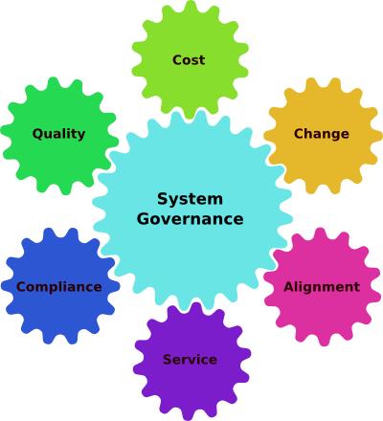


IT Governance, SLA, RFP

Slide 54
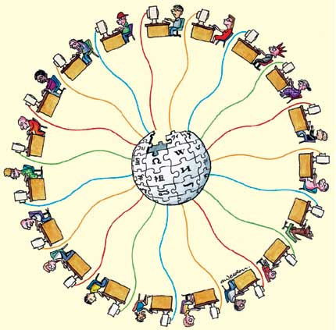


Social media and networking, collaboration tools
Content management systems, Wikis and blogs

Slide 55
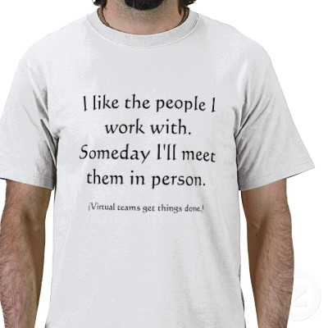

Slide 56

Results Orientated Work Environment
Notes:
ROWE is a human resource management strategy wherein employees are paid for results (output) rather than the number of hours worked

Slide 57
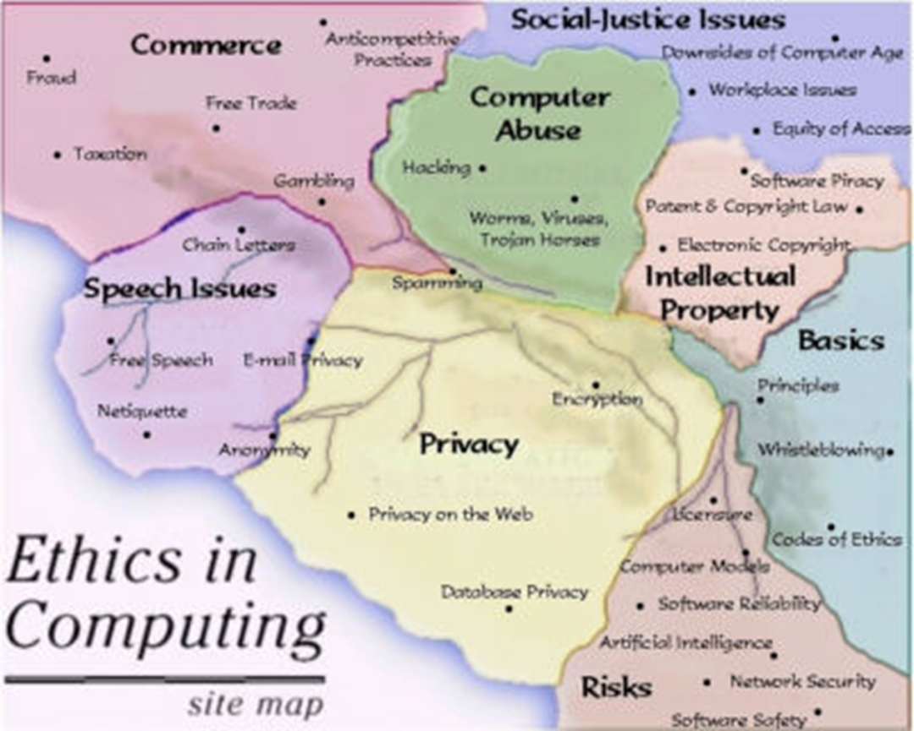

BI, Analytics, BYOD or other interesting topics
Discovery
Notes:
BYOD is Bring Your Own Device and it means– bring your own piece of hardware when you come to our network or premises

Slide 58

What skills will I acquire in this class?

Slide 59
Goals to achieve during this quarter
You should become conversant in Networking concepts
You should become conversant in Cloud Computing and SaaS
You should become conversant in Web 2.0 Collaboration and Communication tools
You should become conversant in social media terminology
You should understand a role for social networking in the enterprise
You will build a CMS for a Blogsite

Slide 60
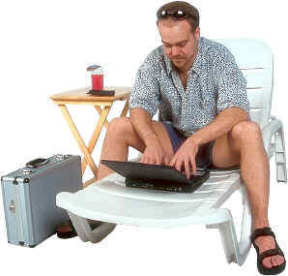
What do I need to know coming in?

Slide 61
Not too much
Basic desktop computing skills
Basic web surfing skills
A fearlessness for installing and trying new software

Slide 62
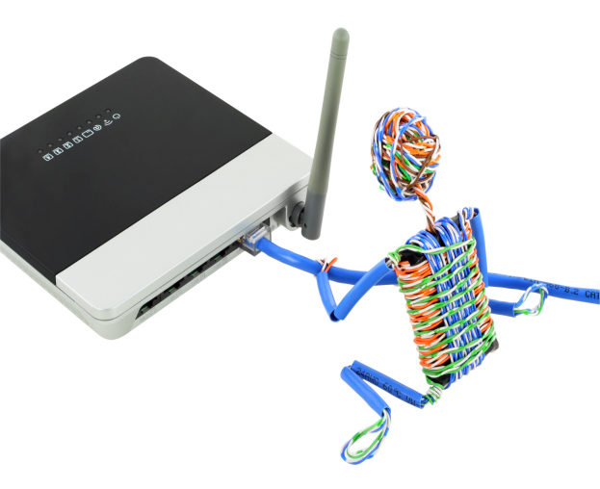
Who do I think I am?
Rajeev Kumar (MSc BIT from DePaul CDM)
rkumar7@cdm.depaul.edu (preferred)
Phone: 312 498-5105
Office location:
Tuesdays and Thursdays (5:15-5:45pm)- In class CDM 206
Tuesdays and Thursdays (9-9:30pm)- CDM709 or CDM206
Feel free to connect to me on LinkedIn

Slide 63
Course Assignments
Web Site Building (Blogsite): 25%
Memo assignments 30%
Discussions (D2L) 10%
Reflection Essay 5%
Final exam: 30%

Slide 64

Good time to discuss resources
d2l.depaul.edu (D2L)

Slide 65

Site Building:
You will build a blog site.
Not a website.

Slide 66

Site Building
You will procure a webhost account and build out a WordPress site*
You will do this assignment alone
You may NOT share a webhost account
Notes:
* I am comfortable if you would like to build a Joomla site as well; However my time to help is limited on this.

Slide 67
Webhost Accounts
You can select any web host company
I recommend Siteground (get to the link off of the Guideline doc on D2L)
Using your DePaul email, you can get hosting from Siteground for free (1 yr). If you want a custom domain name, it will cost $14.95 for the year.
If you must choose something other than Siteground, it must be a paid site (the free ones are lacking in most of the tools you will need)
There is no book.

Slide 68
Web hosting -- Notes
Look for:
Domain Registration (free or low cost)
Unlimited storage
Unlimited (or at least 10 email accounts)
Control Panel (C-panel)
Wordpress 1 click install support (more than one instance)
Multiple (better unlimited) mySQL databases (this will determine how many WordPress sites you can install)
Determine your domain name before you start the process!! (if going for a paid domain)
Stay away from GoDaddy, hostgator etc
www.siteground.com/depauluniversity

Slide 69
A word about your URL
Think about it before you jump to purchase your webhost account. In fact it is a good idea to do the first Web Assignment BEFORE purchase
With the free Siteground site you will be given a generic subdomain. This is acceptable.

Slide 70
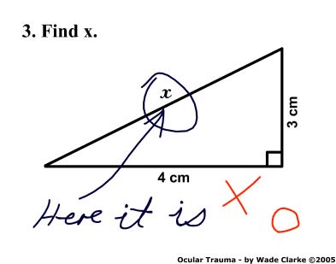
Final Exam
It will be a take home exam.
Exam is due July 19, 2015 11:30 pm

Slide 71
Memos
Must use standard memo format (to: from: date: subject: <body>
Body – These parts
Statement of the issues addressed in memo
Recommendation
Read the background material before you make the recommendation
Justification
References (citations -2 for each memo for supporting material)
Memos missing citations will be UNACCEPTABLE (Points deducted)

Slide 72
More on Memos
There will be a total of 7 memos
For Graduate students (ECT424):
I will drop the memo with the 3 lowest scores
In other words, four of the seven memos will count towards your grade
For Undergraduate Students (IS324):
I will drop 4 memos with the lowest score
In other words, three of the seven memos will count towards your grade.
Note: ALL students though are required to do Memo #3 and #5
The final exam is a set of memos – these become practice for the final exam.

Slide 73
One more on Memos
One of the objectives is for you to demonstrate your understanding of the material (conversant – right?)
If all you do is long quote blocks, you are not demonstrating your understanding.

Slide 74
Memo Grading
Grading is on a 3 grade scale
5 – acceptable
3 - flawed
1 – unacceptable

Slide 75
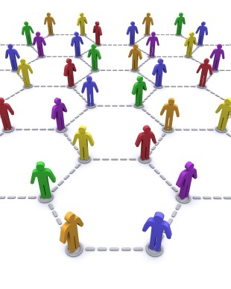
Discussion Participation
In class discussion, in person -BEST
There are discussion boards these add to your participation grade
We’ll try to discuss the memo one class BEFORE they are due or do a group activity about the memo topic.

Slide 76
Discussion board
Each student must submit a post every week
You can comment on ANY post on the board
Comments at D2L
You must make at least 2 comments each class (total of 20 for the course)
You must make the tie in to the class – Enterprise Architecture/Infrastructure (topics of discussions are based on class content)

Slide 77

Reading for next class
See D2L – Class 2
We will talk about: LAN protocols, Internet Routing, DNS, Wireless, and whatever other topics seem interesting next class
You should be prepared to talk about your blogsite context

Slide 78
Website Assignment 1
Assignment 1 –Your context document.
Due 6/23/2015, 5 pm to D2L

Slide 79
Website Assignment -- Details
Assignment 1 -- Context
This will define the context (story) for your website
You may choose to do TRU (the company for the memos) or you may choose to do a personal blog
In any case you must answer these three questions:
What community do you plan to serve (who will make comments and why)?
What value are you going to provide (why would people return to your site over and over again)?
Who would be responsible for writing content on your fictional blogsite? (not you, what role would do it?)
Notes:
Context = reason for being. What community are you trying to reach?
NOTE: you will not actually fill out the blog with live content. The only content required is some relevant posts about the context. You my choose to add “live” content if you choose.

Slide 80
Web1
Once you write up your context:
You will post the Word/pdf doc to D2L
Be prepared to discuss next class
Eventually you will also post this material to your blogsite (part of Web 2)
Refer to D2Lto guide on how to install Word Press.
Note: Cache – turn it off!
www.siteground.com/depauluniversity

Slide 81
In a nutshell -- For Next Class
Introduce yourself on D2L to your fellow students. Tell us about yourself.
Develop your Wordpress Blogsite Context. Think carefully about this!
Read the TRU Background materials
Read the materials for next class

